Slide 1

Data analytics career accelerator 2023 cohort 2 Course 3 Assignment: Advanced Analytics for Organisational Impact
Student name: Rose Ryan
Submission date: 19 October 2023

Slide 2

introduction

Slide 3
Introduction
Turtle Games is a game manufacturer and retailer with a global customer base which manufactures and sells its own products, along with sourcing and selling products manufactured by other companies. Its product range includes books, board games, video games and toys. The company collects data from sales as well as customer reviews. Turtle Games has a business objective of improving overall sales performance by utilising customer trends.
Turtle Games wants to understand:
how customers accumulate loyalty points
how groups within the customer base can be used to target specific market segments
how social data (e.g. customer reviews) can be used to inform marketing campaigns
the impact that each product has on sales
how reliable the data is (e.g. normal distribution, skewness, kurtosis)
what the relationship is (if any) between North American, European, and global sales

Slide 4
Importing and Exploring the data
A new Jupyter notebook was created for the project using the Anaconda environment, so Python could be used for the first part of the analysis
A new R file in R Studio was created for the project in order to use R for the second part of the analysis
The required libraries for analysis and visualisation were imported into the new Jupyter notebook and R Studio file respectively
The data sets provided (turtles_reviews.csv and turtle_sales.csv) were imported into the Jupyter notebook and R Studio environments respectively
The descriptive statistics and metadata of the DataFrames were determined

Slide 5
Identifying Trends and Patterns

Slide 6

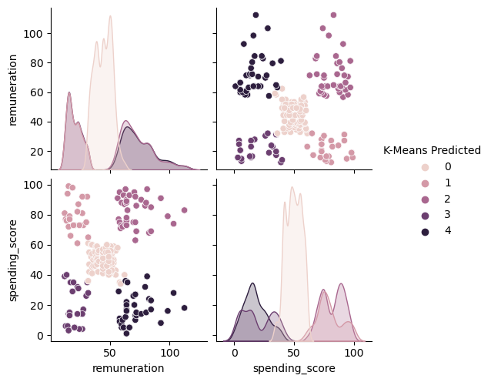
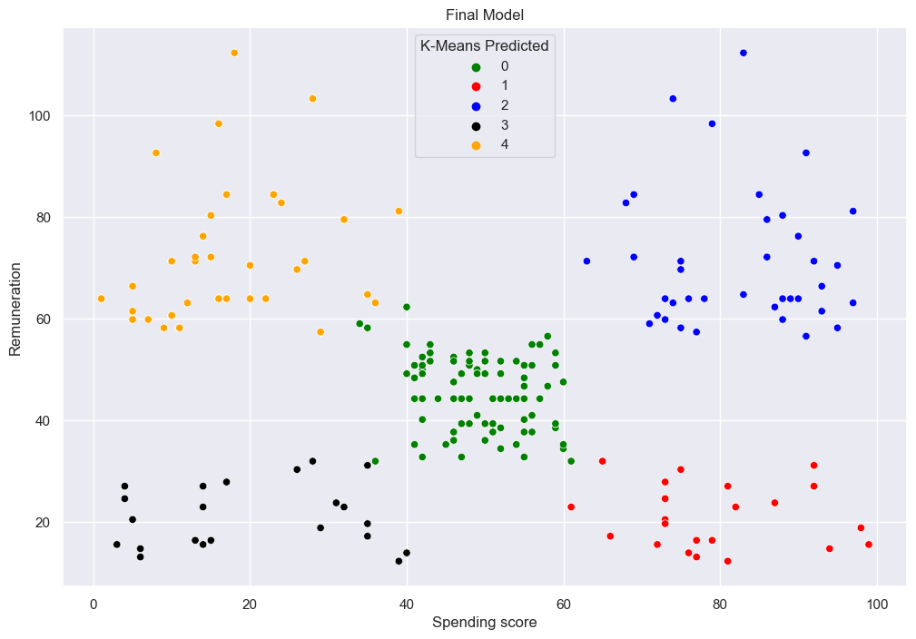
Customer groups for targeted marketing
Remuneration and spending score showed five clusters when plotted in a pairplot, which was also confirmed by both the Elbow and Silhouette methods
K was set at 5 and K-means clustering was carried out
This would suggest it would be most effective to target customer groups in five different and independent ways

Slide 7
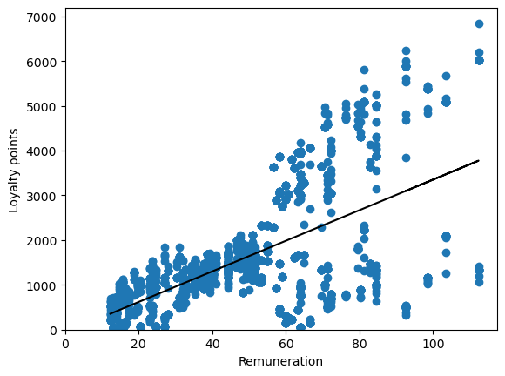
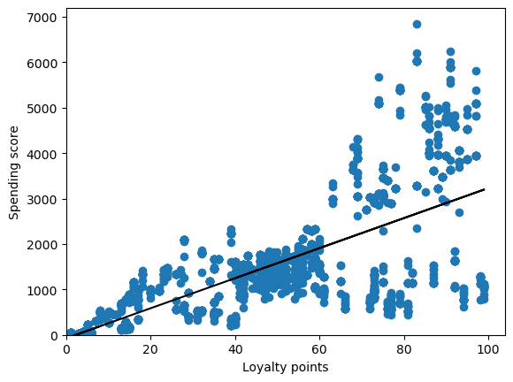
How customers accumulate loyalty points
Spending score vs. loyalty points showed a positive correlation
Renumeration vs. loyalty also showed a positive correlation
Age vs. loyalty did not show a correlation

Slide 8
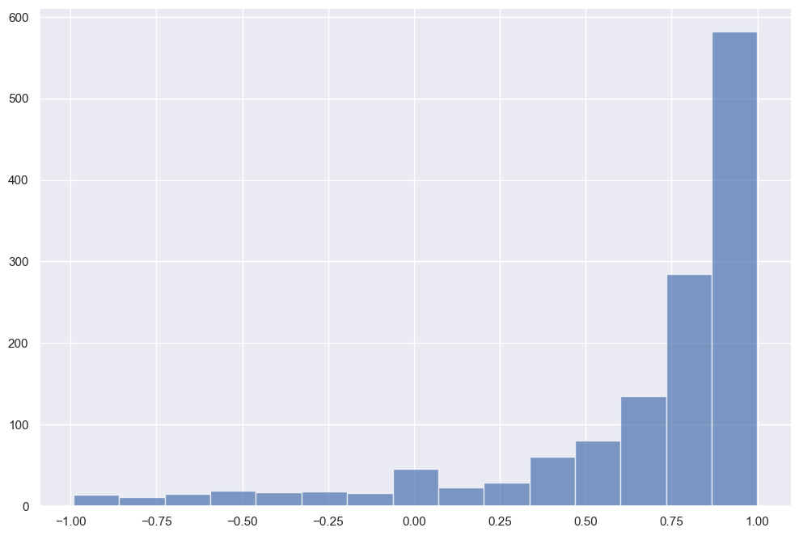
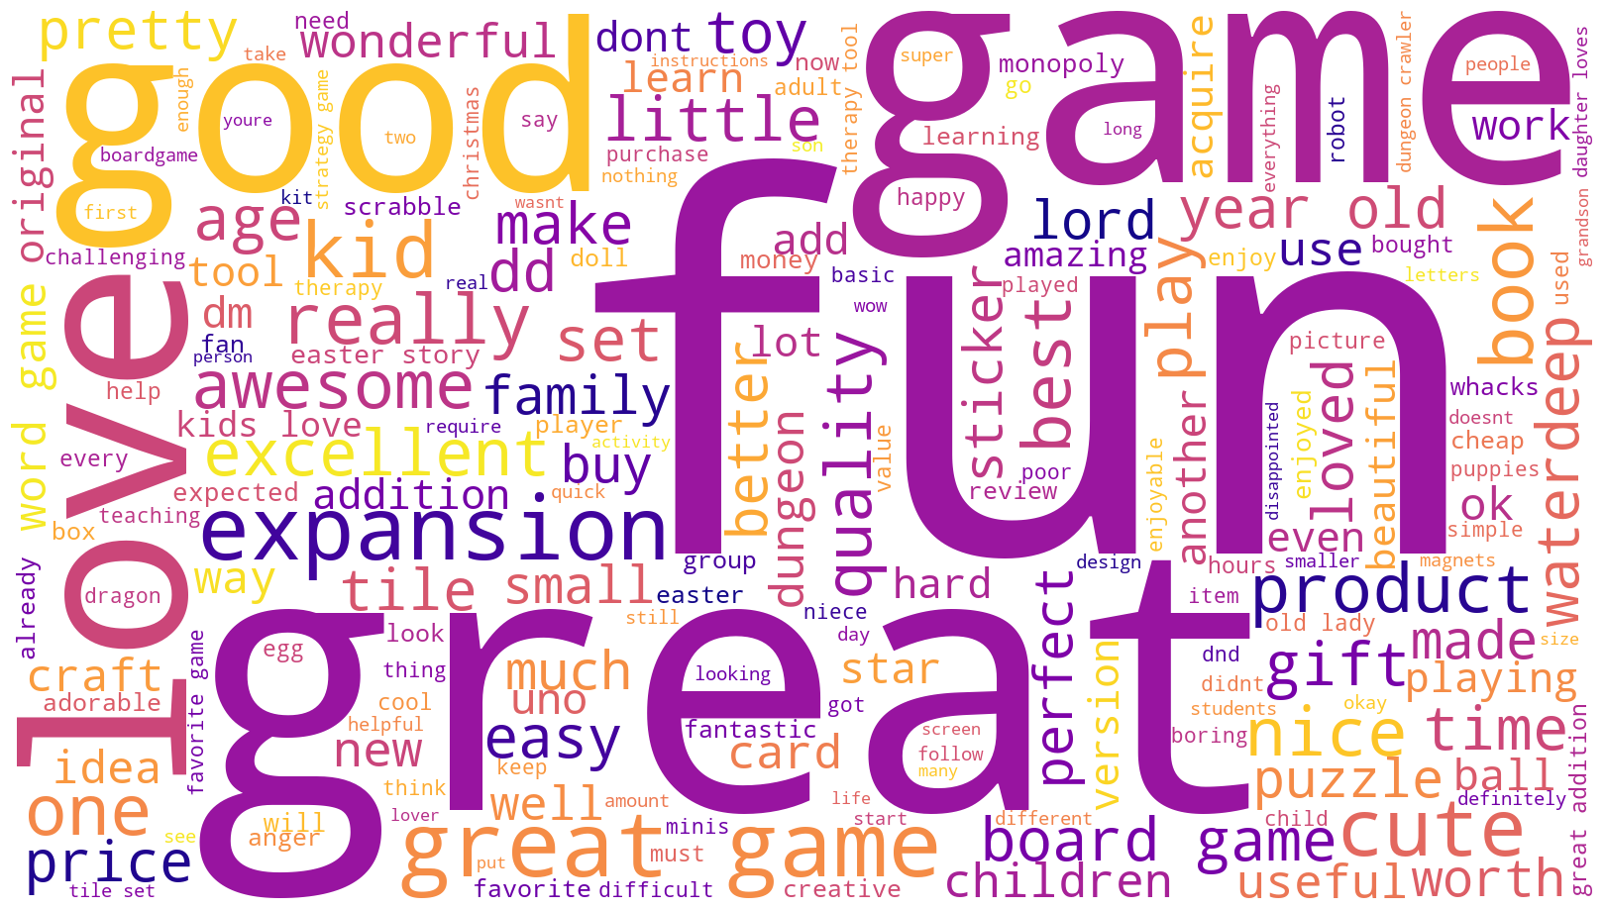
NLP analysis of review text
A WordCloud for review text was created after stopwords had been removed which shows an easy-to-read visual of the most commonly occurring words in the reviews, which are objectively positive
The polarity of reviews was calculated and showed a strong positive result, with over 50% of reviews scoring between 0.75 and 1.00

Slide 9
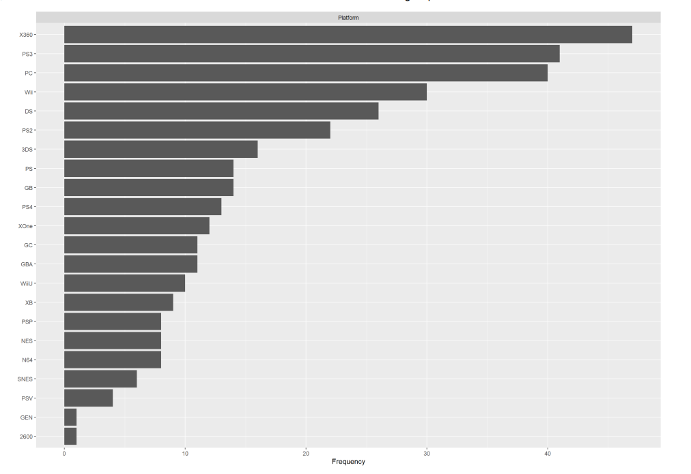
how different products affect sales trends
The top three platforms are:
Xbox 360
PlayStation 3
PC

Slide 10
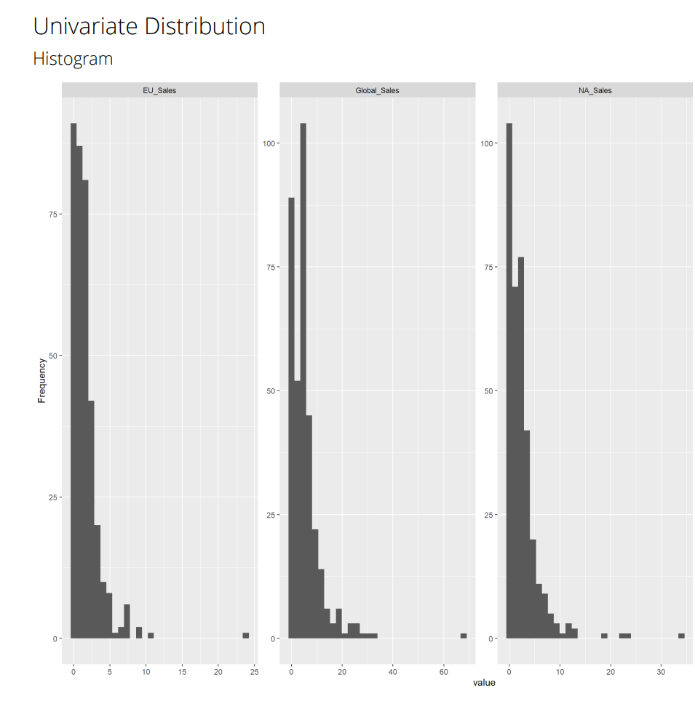
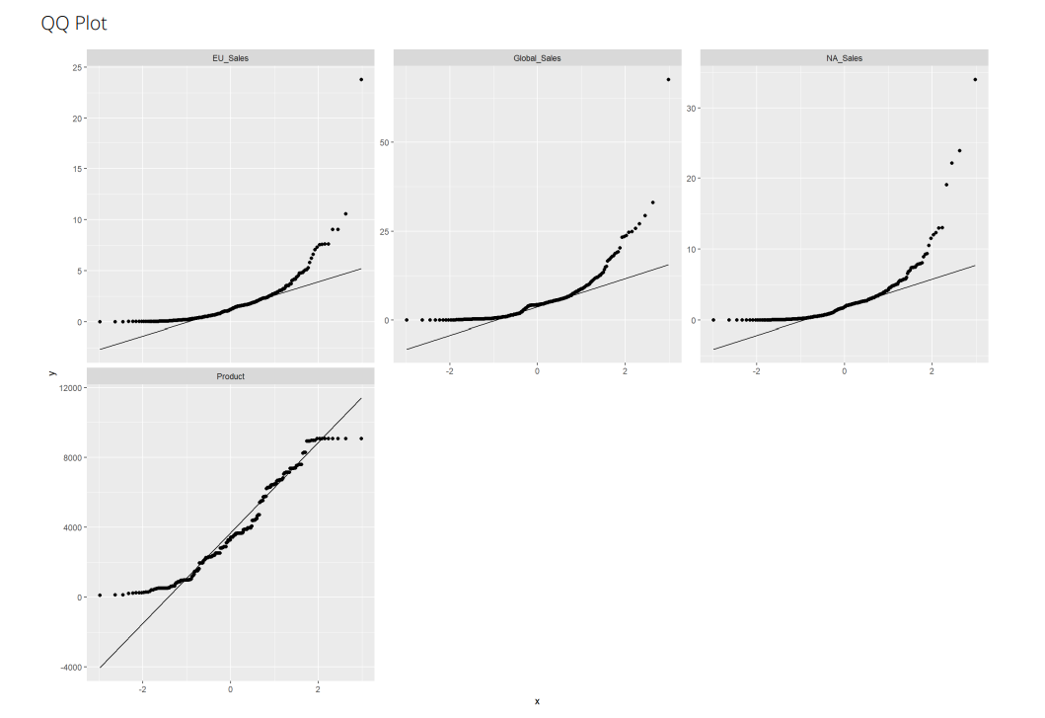
Reliability of the data
The QQ Plots show a right skew to the data for all regional sales categories
The histograms show a negative skew to the data

Slide 11
Recommendations

Slide 12
Recommendations
When targeting specific customer groups, this should be approached in five different ways, based on the distribution within the customers for renumeration, spending score and loyalty points
Customers with lower spending should be targeted more in marketing in order to attempt to increase their spend within the environment
The platforms with lower-performing figures could benefit from improved marketing and advertising
Reviews are mostly positive, based on the WordCloud, fifteen most commonly occurring words, and polarity, so there would not be a great deal of work needed to be done to improve upon this for the online presence of Turtle games

